Slide 1


DIO Participation in Graduate Medical Education Transformation:
SI Role in Change
July 8, 2026
Abraham Nussbaum, M.D.
Chief Education Officer, Denver Health
Professor of Psychiatry & Asst. Dean, CUSOM

Slide 2
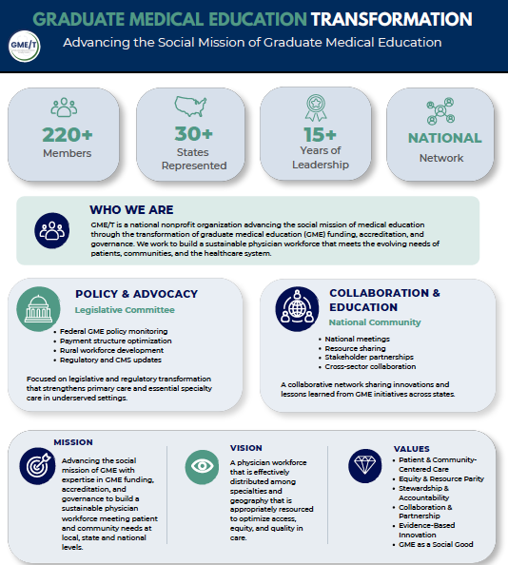



Slide 3
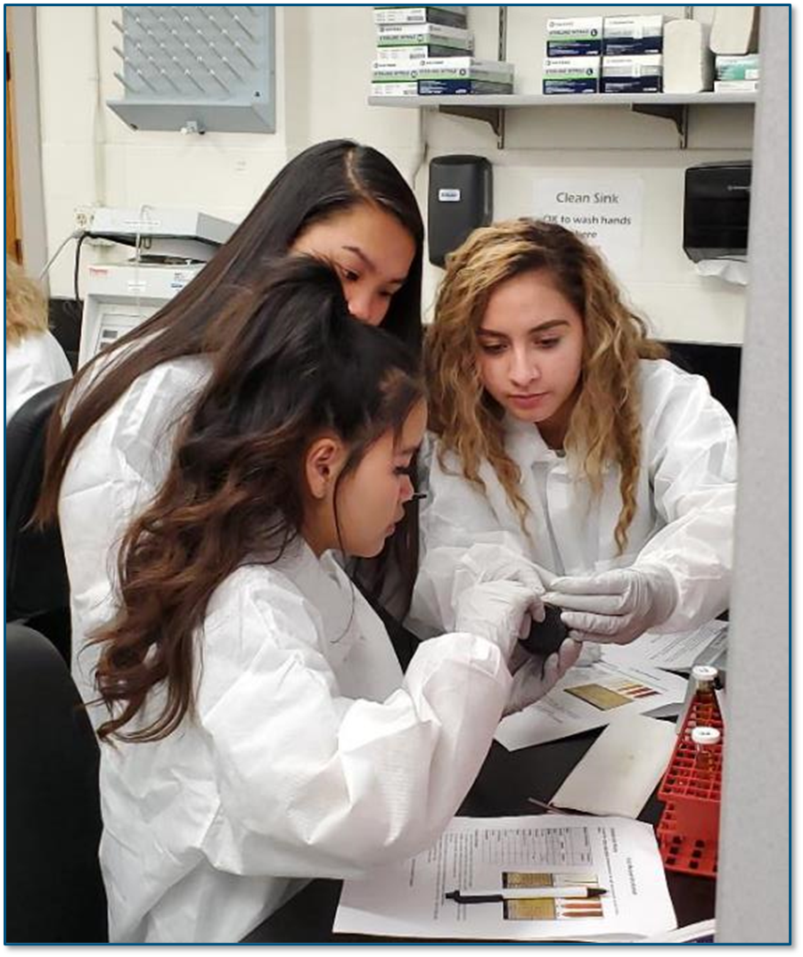
Today’s presentation
Introduces the DIO role
Shares 10 ways a DIO can advance transformation in graduate medical education
…and why resident physicians are like vampires

Slide 4
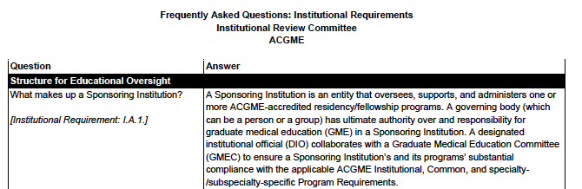
Definition of a DIO

Slide 5
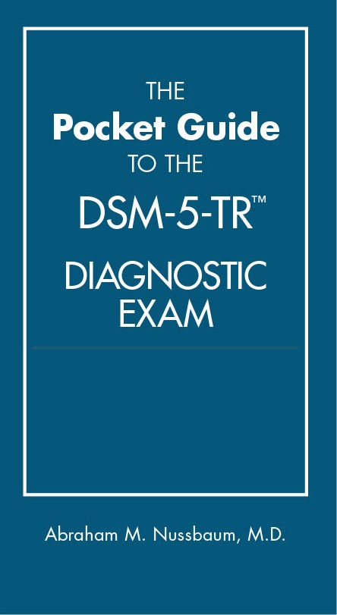
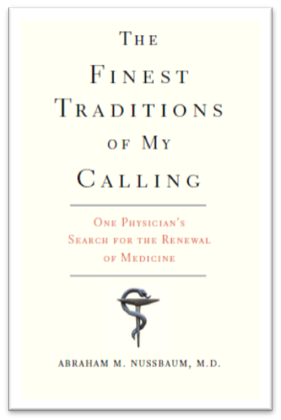

Conflict of Interest Disclosure
Salary from Denver Health
Royalty payments from American Psychiatric Publishing, Yale University Press, Johns Hopkins University Press
Previous grant support from the University of Chicago, Department of Justice, Victims of Crime Act, HRSA
Current grant support from CDPHE, CDLE, Duke
No past or present industry relationships

Slide 6
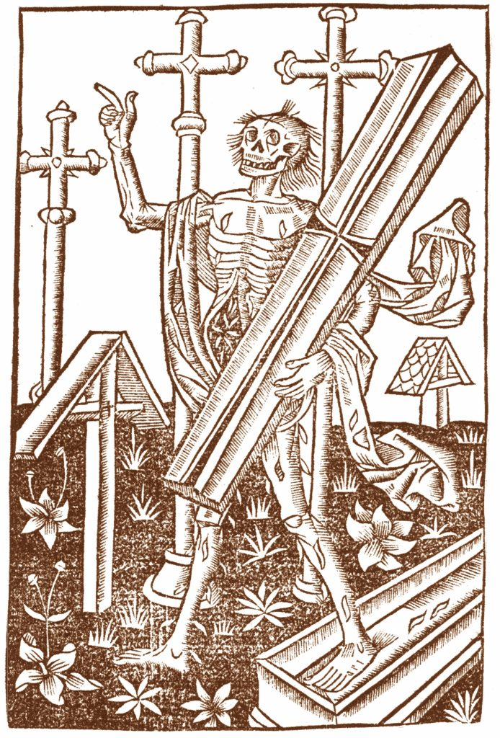
One-LINE AI SUMMARY of Progress Notes:
After five years watching medical students closely, I learned entering the Match is less about choosing a specialty and more about choosing which kind of monster to become: Hero, Ghost, Werewolf, or Vampire… and that we help them choose better if we build community & continuity.
German woodcut of a revenant, circa 1500

Slide 7


We often call doctors heroes; because, like heroes, they save the day.
But heroes are celebrated for flying away unchanged.
In real life, saving the day changes you, wears you out.
When heroes burnout, they become ghosts.

Slide 8
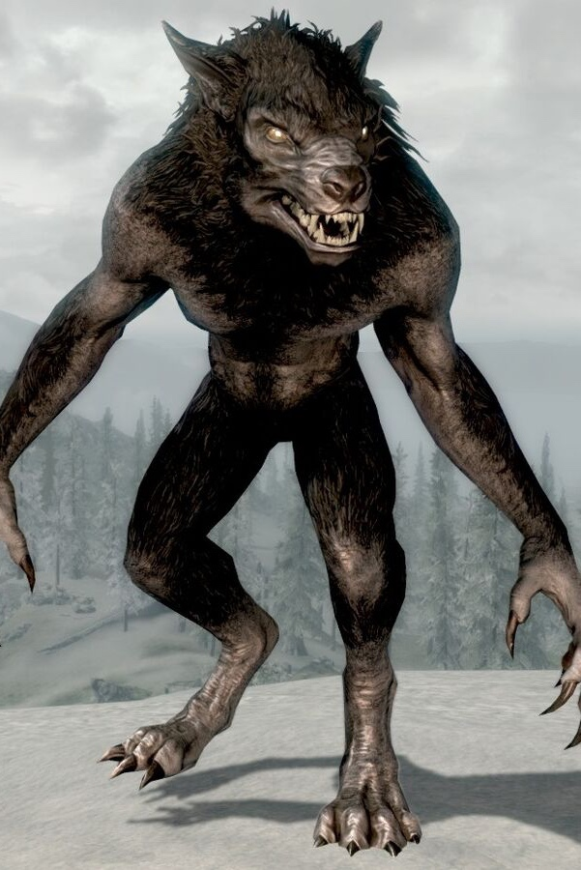
To prevent burnout, we’ve added wellness initiatives which have recast residency as shift-work.
In pursuit of work-life balance, today’s residents go back and forth between periods of intense labor in the hospital and being off service.
This back-and-forth is what the shape-shifting werewolves do.

Slide 9
As a DIO, my job is to make better monsters: vampires.

Slide 10
As a DIO, my job is to make better monsters: vampires.

Slide 11
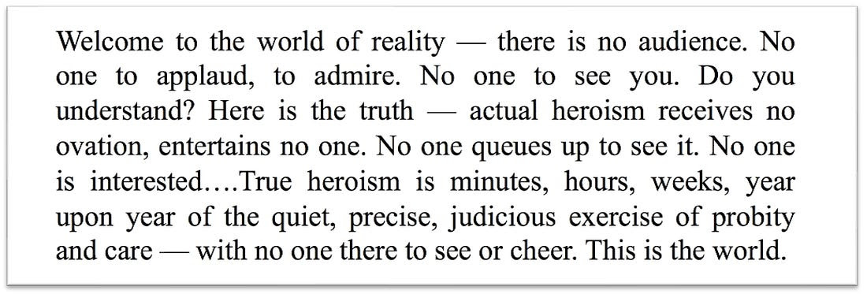
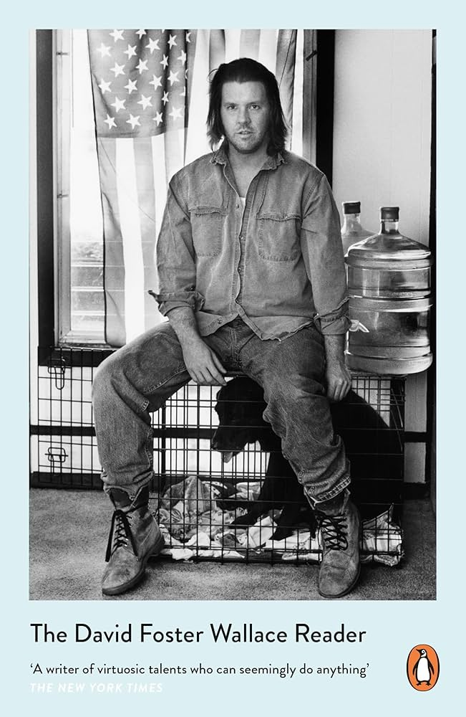
--David Foster Wallace

Slide 12
Medical training was a disorienting and reorienting experience
…
…like parenting, but also,
strangely, like becoming
a vampire
Sergei Prokudin-Gorsky, White fox. Stuffed animals from the collection of N. P. Alin in Cherdyn, 1910, digital color composite by Blaise Agüera y Arcas, 2004

Slide 13
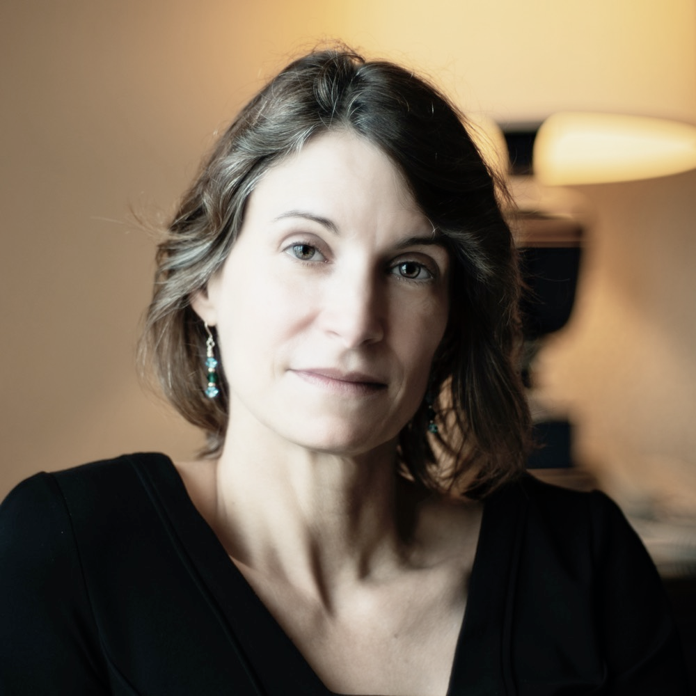

Q: What do parents, physicians, and vampires have in common?
A:

Slide 14
Parents, physicians, and vampires aren’t noble heroes or shift workers, but transformed people who live differently than they did before…
… For intrinsic reasons.
You parent to parent, you doctor to doctor, you vampire to vampire, not for extrinsic goods.

Slide 15
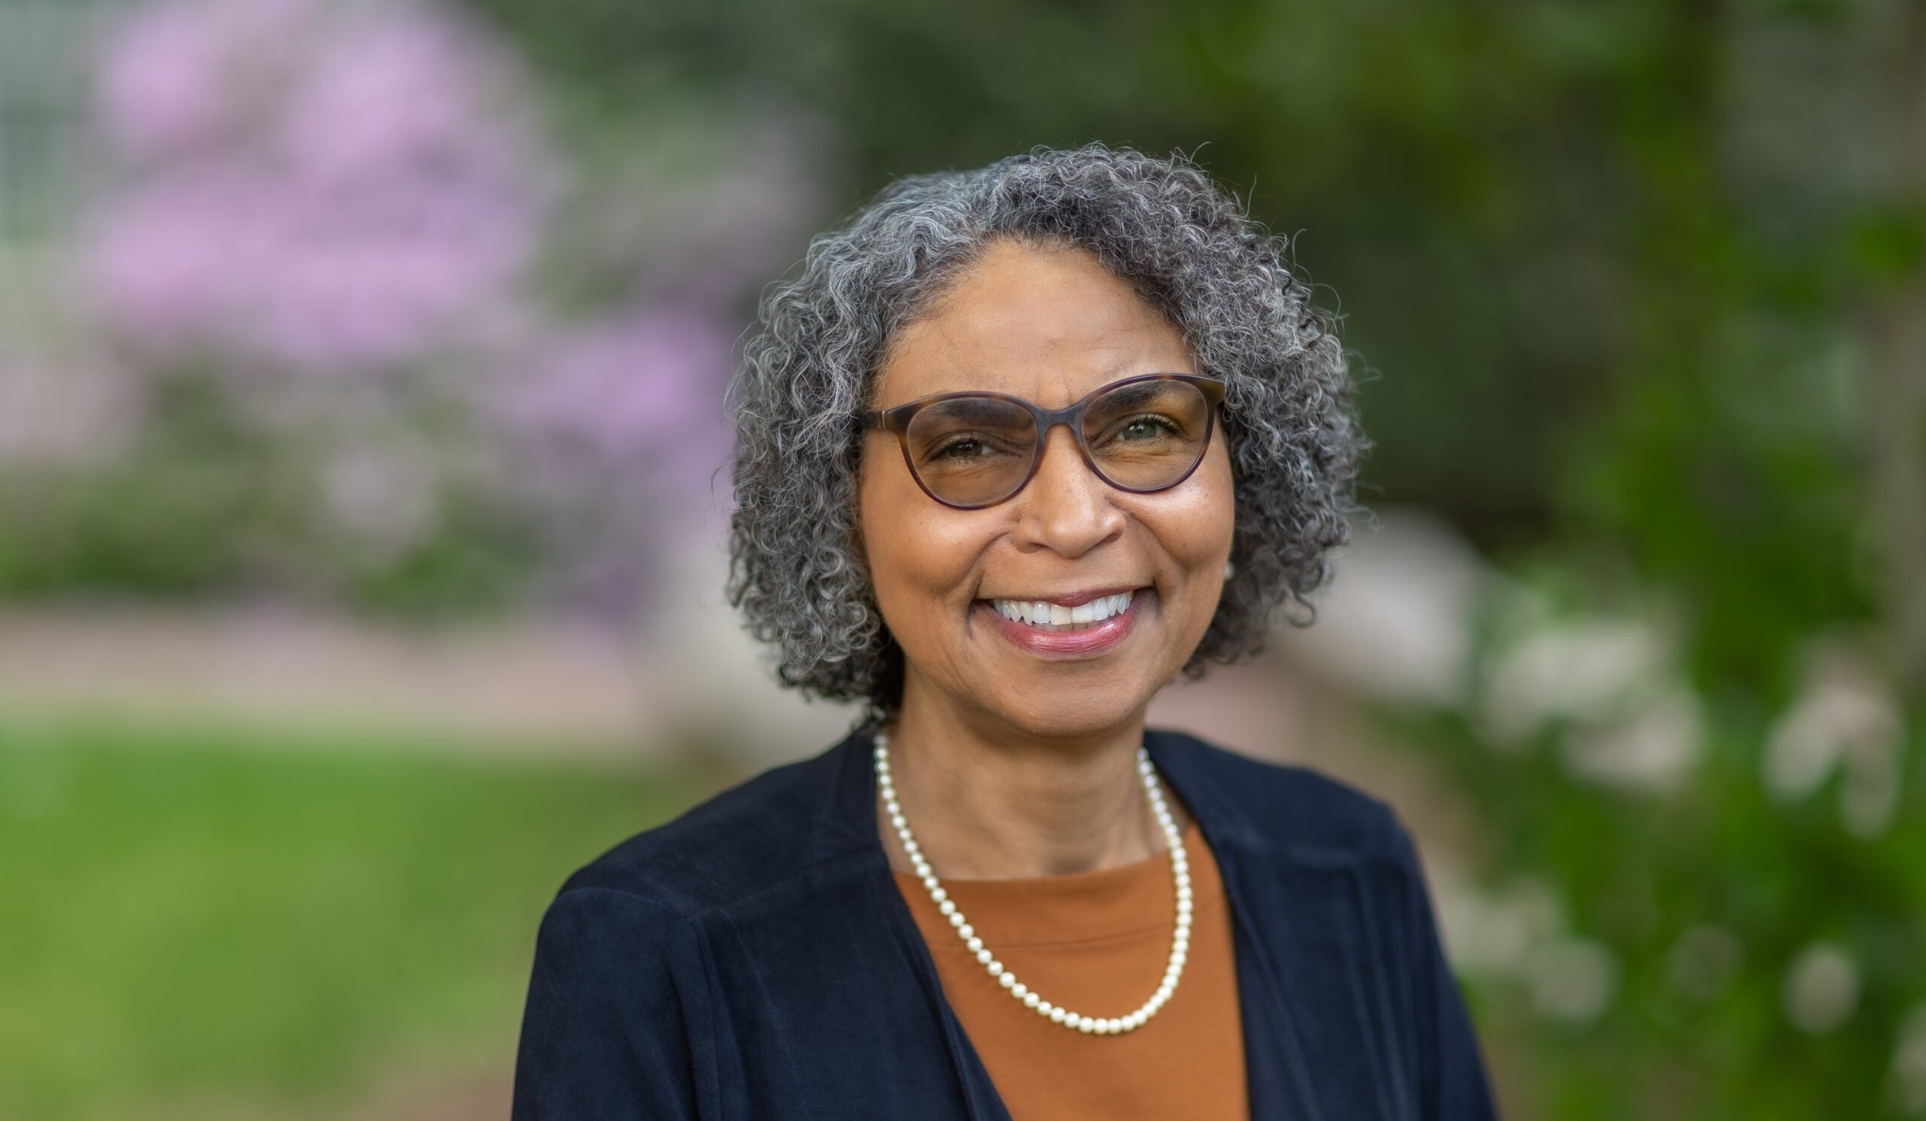
Thank you to Georgette Dent, MD
Assoc. Dean Of Student Affairs
Encouraged me as I began triple-vampire training.
In one 18-month period, I married, welcomed our first child, and entered the Match to decide what kind of physician to become.

Slide 16
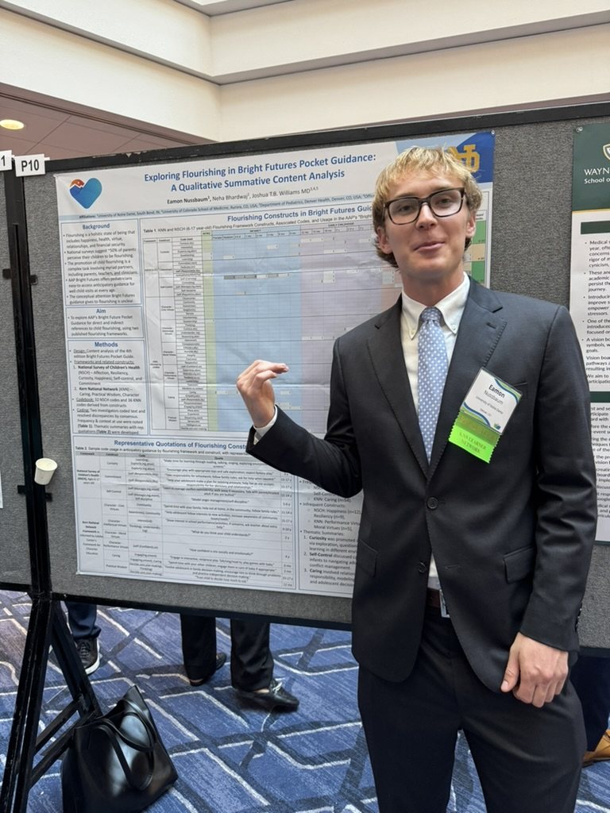

Baby→ 1st Research Poster
My favorite pre-med: Eamon Nussbaum

Slide 17
Train VAMPIRES Like Hippocrates
“For the physician sees terrible sights, touches unpleasant things, and the misfortunes of others bring a harvest of sorrows that are peculiarly his; but the sick by means of the art rid themselves of the worst of evils, disease, suffering, pain and death.”
--Hippocrates
Credit: Hippocrates head in Musee National Athens. Wellcome Images

Slide 18
#1 Know The Rules & The Role
Demonstrate your excellence: no one else should understand AGME rules as well as you.
Develop immaculate GMEC minutes.
Invite leaders to your GMEC.
  The GMEC can be dull/dry. Make it relational, connecting learners and leaders.
Punchline: You must know the rules to drive change.

Slide 19
To Flourish as Vampires, We Need Continuity
In long-running flourishing studies, what matters most in life are structured relationships.
The good news: most of us got into medical education because we like to build mentoring relationships.
Punchline: we don’t need heroes to save the day, but “vampires” committed to the daily work
Avoid smoking and alcohol abuse.​
Employ mature defense mechanisms, like humor, when life gets hard.​
Stable marriage. “Happiness is love, full stop.”​
Maintain a healthy BMI​
Engage in some regular exercise​
Years of education are associated with improved happiness. ​
Generativity: Build a good life, a well-rounded self, and then give back.
Reference: Vaillant 2001, Waldinger 2023

Slide 20
#2 Remember ‘The Ceiling is the Roof’
The DIO role is really what Hegel called an ‘empty formalism’… you’re better off following Michael Jordan
Don’t get trapped by following accreditation standards.
  Not designed for most SIs
  Not designed for transformation
Punchline: The role is too abstract, so define a vision, map a strategy, or purse a telos which serves your learners and institution.

Slide 21
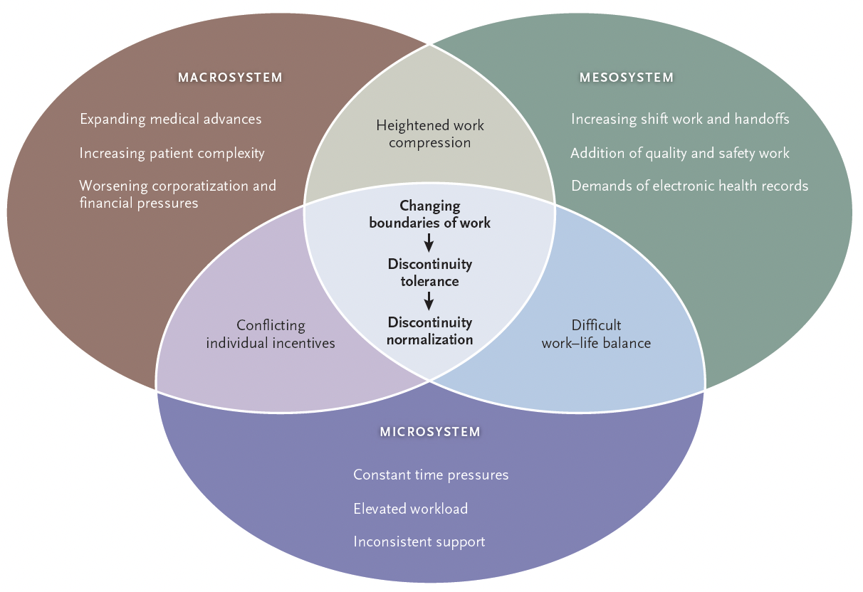
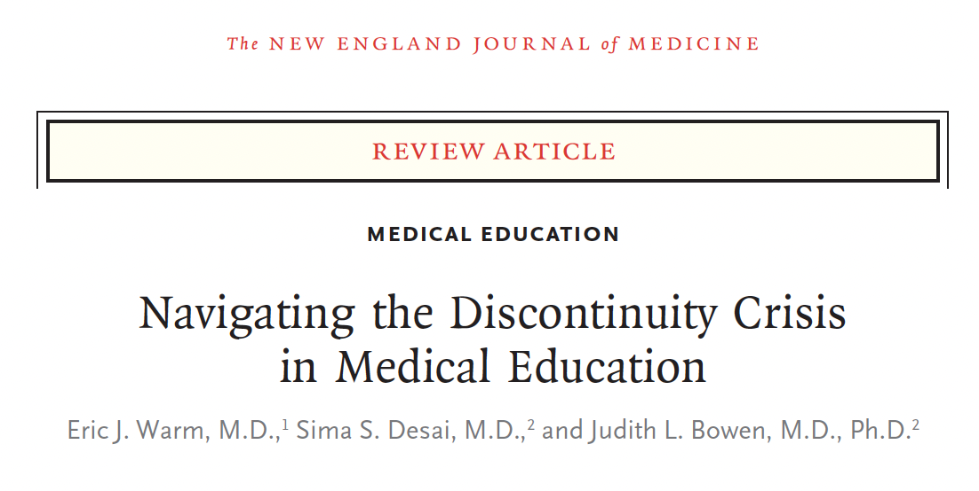
What gets in the way: discontinuity
Ref: Warm et al. 2025

Slide 22
#3 Learn Your Cost Report
GME financing does not make sense, but you need to make some sense of it to serve your SI
  Learn: Mary Jo Wagner Central (Central Michigan), AAMC, and the GME-T Board
Centralize budgets when you can, because of your expertise, not because of control--> gives you authority the ACGME roles do not mandate.
Punchline: You can affect transformation only after figuring out where the money flows.

Slide 23
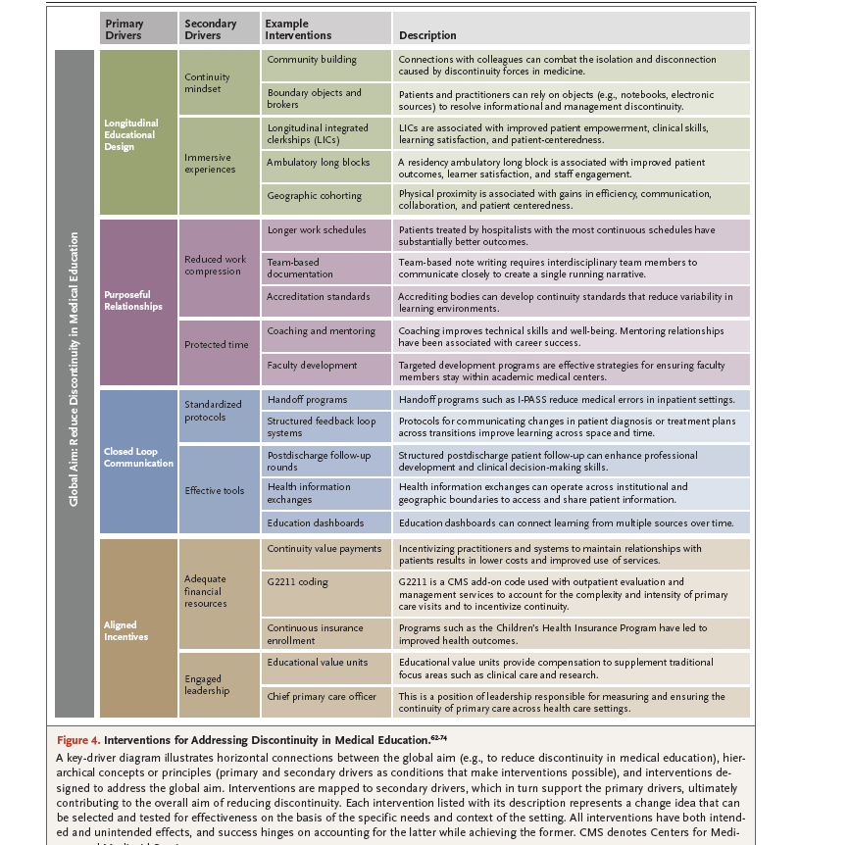
Continuity Interventions Build Vampires
In this driver diagram, the authors cite:
Longitudinal education design
Purposeful relationships
Closed loop communications
Aligned incentives
Each advances flourishing, so build those structures at every level
Ref: Warm et al. 2025

Slide 24
#4 Build Your Team
The ACGME does not mandate many roles
Whether direct or dotted, you’ll need a team
  Driver diagrams or other tools to motivate folks
  Regular check-ins and celebrations
  Succession planning
  Institutional: understand authority within your institution; make the most of your time with the Board (AIR)
  Local: other SIs, specialty societies, legislative teams
Punchline: It’s lonely to be the only GME expert.

Slide 25
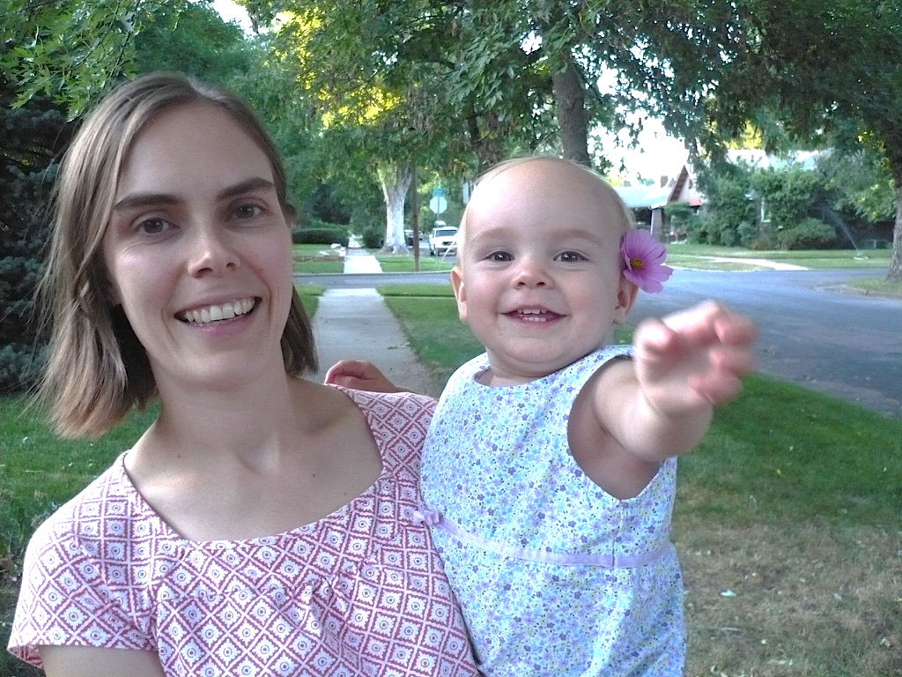
Vampire Strategies for Medical Students
Longitudinal educational design: Choose training programs like the LIC (and other continuity models) which foster relationships over time. Ask: Do your students have mentors? Small group learning sessions?
Purposeful relationships: Attend class. You never know whom you might meet.→
Closed loop communication: Read one poem a day. Practice asking follow-up questions.
Aligned incentives: End your day with a roses, buds, and thorns exercise.

Slide 26
#5 Smell Like The Sheep
Pope Francis says “a good shepherd smells like the sheep.”
  A DIO can get stuck in email and meetings.
The root word of Doctor is Teacher.
  Teach and doctor so you have some sense of what’s happening
  Teach and doctor so you model curiosity and humility
Punchline: You can know better which transformations to seek if you’re out in the field.

Slide 27
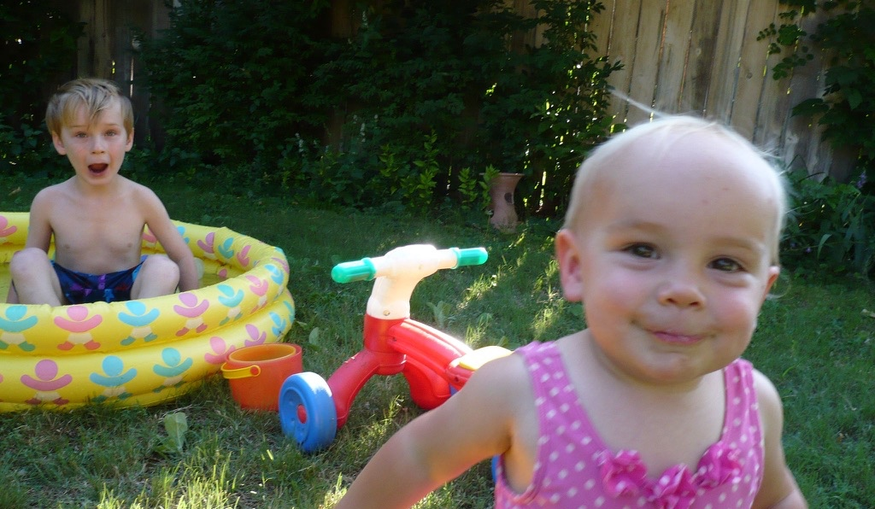
Vampire Strategies for Resident Physicians
Longitudinal educational design: Invest in mentors and peers and you will know them the rest of your life. Ask: how active is your alumni association?
Purposeful relationships: Buy a crockpot. Join a faith community. Get a library card. Appreciate this as a training season of your life, but it is your life. Remember to live your life now. Be thoughtful about delaying partnering and parenting for medicine. Ask: what are you family medical leave policies?
Closed loop communication: Develop a reading practice with physical books, even if it’s picture books.
Aligned incentives: Choose training in safety-net settings. At the end of every day, name the people you helped.

Slide 28
#6 Keep An Open Door
Meet regularly with your program directors.
  Discuss development and succession plans.
Host orientations with residents, teach a session of their didactics, buy them a cup of coffee.
  Survey sooner than the ACGME annual survey and ask different ?s: Is this making you wiser, more just?
Punchline: Lower the barriers to communication.

Slide 29
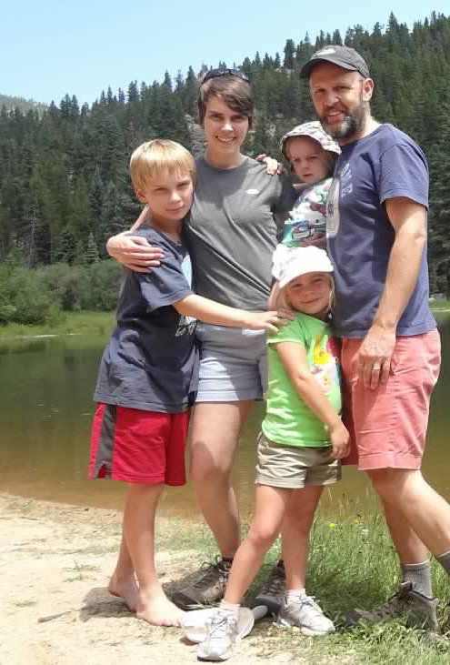
Vampire Strategies for Attending Physicians
Longitudinal educational design: Ask for a mentor and build a birdhouse together. Build a junior faculty supper club.
Purposeful relationships: Join a community group where you are measured differently. Active commuting→ try biking to work. Offer to buy med students and residents a cup of coffee. Write a paper with a trainee. Build exercise into rounds.
Closed loop communication: Try reading novels again. Give formative feedback.
Aligned incentives: Say yes to every measure of you as a mentor and “okay” to every measure of productivity. Keep a book of your students and trainees.

Slide 30
#7 Never Waste A Rainy Day
Hope for a good weather but always be prepared.
If you know the rules and the funds flow, along with the local and national scene, you can start seeing weather before it arrives.
Demonstrate your excellence by anticipating bad weather
Punchline: Maintain a list of transformations you can implement when the right weather arrives.

Slide 31
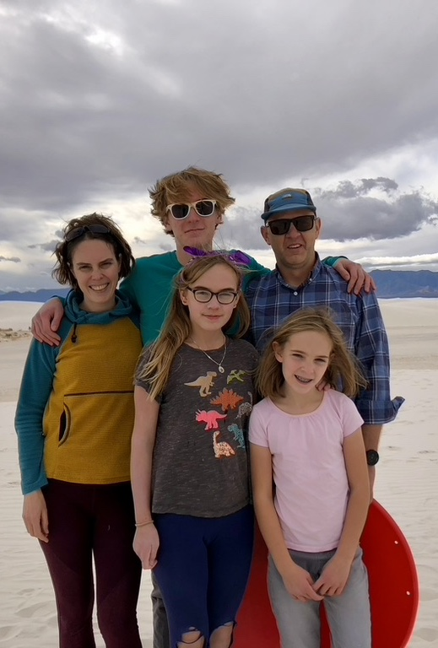
Vampire Strategies for Program Directors
Longitudinal educational design: Make sure every trainee has a mentor (and you do too…). Develop electives at community sites.
Purposeful relationships: Join a community group where people use “milestones” differently. Organize a monthly dinner of peers.
Closed loop communication: Read the HBR summaries of business books, but all the works of a favorite author.
Aligned incentives: Keep a bulletin board– real or virtual– of your trainees and their families. Say ”yes” to mentor opportunities. Join the GME-T to advocate for change.

Slide 32
#8 Get Out of Town
If you’re the only one who knows what works, you’ll need other ways to learn.
Take the Reading Cure
Build your national network: NADIO, AAMC, ACGME, GME-T
  Know the benefits and limits of each
  Submit posters and presentations
Punchline: Travelling expands perspective on what is possible.

Slide 33
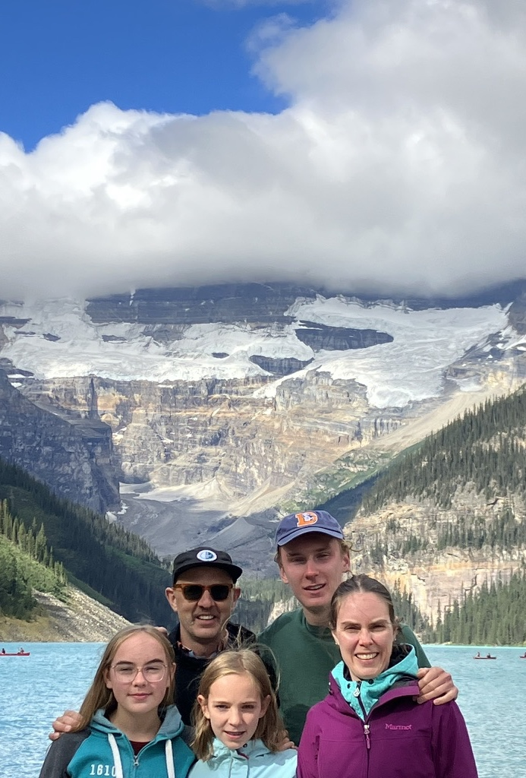
Vampire Strategies for DIO’s/Deans
Longitudinal educational design: Develop training programs which serve community needs.
Purposeful relationships: Distribute lists of community resources to every trainee. Approve community electives. Host an art exhibit and teach visual thinking strategies. Advocate for family leave. Plant a garden residents can use. Invite alums for grand rounds. Exercise 2-4/week. Plant a community garden.
Closed loop communication: Keep a Sabbath. Read philosophy again. Ask trainees and PDs: “What are you reading?” Include a resident story in your AIR.
Aligned incentives: Measure number of dependents. Incentivize language fluency. Measure and reward PD tenure – watch for Year 3. Develop a sabbatical system.

Slide 34
#9 Remember How Hard It is to Become a Vampire
If we’re grateful for our journey, we forget the bad stuff
Appreciate the developmental stages of residency
  Callrooms as dorm rooms
  Meal cards as unlimited meal plans
  Help your institution give residents the benefits of employees and the grace of learners
Build mental health care at multiple levels to lower barriers
Punchline: Transformative experiences are hard.

Slide 35
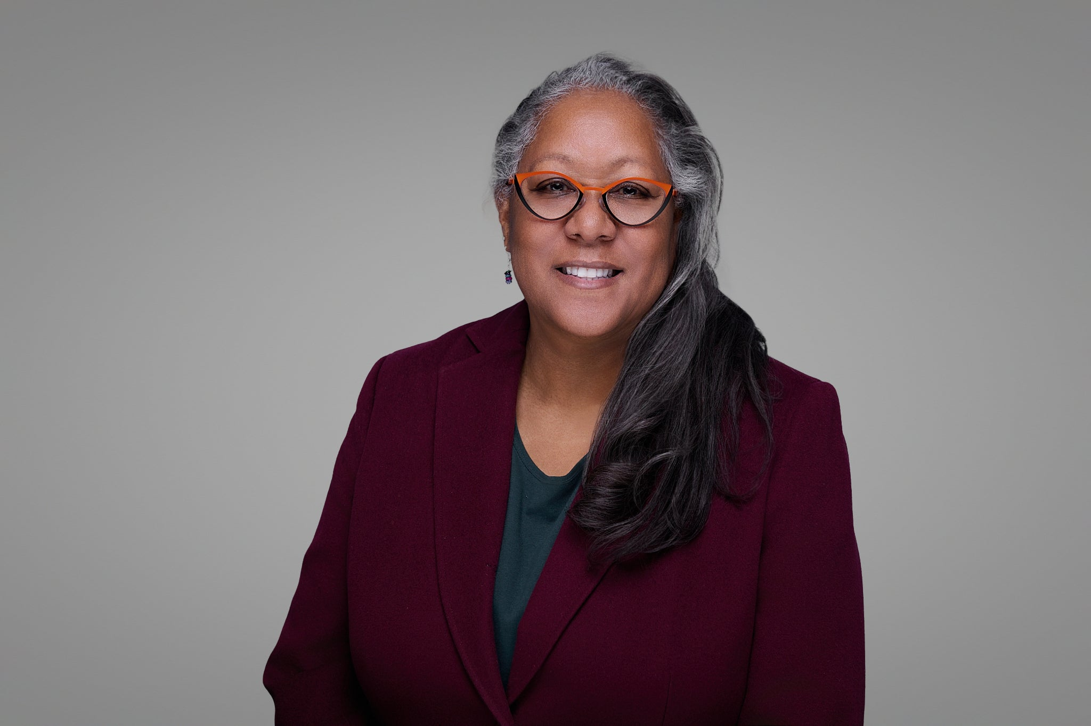
Thank you to Karon Dawkins, MD
PD + Vice Chair of Education
25 years last week

Slide 36
#10 Love the People who Made you a Vampire
What if, beyond continuity within the profession, we sought continuity with the communities which ultimately sustain us?
In a polarized society, we need a two textbook approach to rebuild trust in a medicine which truly serves “the general interest of the community.”
Punchline: A community-serving GME system is the true transformation.

Slide 37

Learn Vampire Strategies with Others

